Slide 1

HDB Resale Flat Trends
Muhammad Iylia Bin Mohd Hutta
P7474841
NSDDA1/CE/2220/4

Slide 2
Datasets
Resale Flat Prices
HDB Resale Price Index
Number of Applications Registered for Resale Flats
Completion Status for HDB Developments
Bookings for New Flats

Slide 3
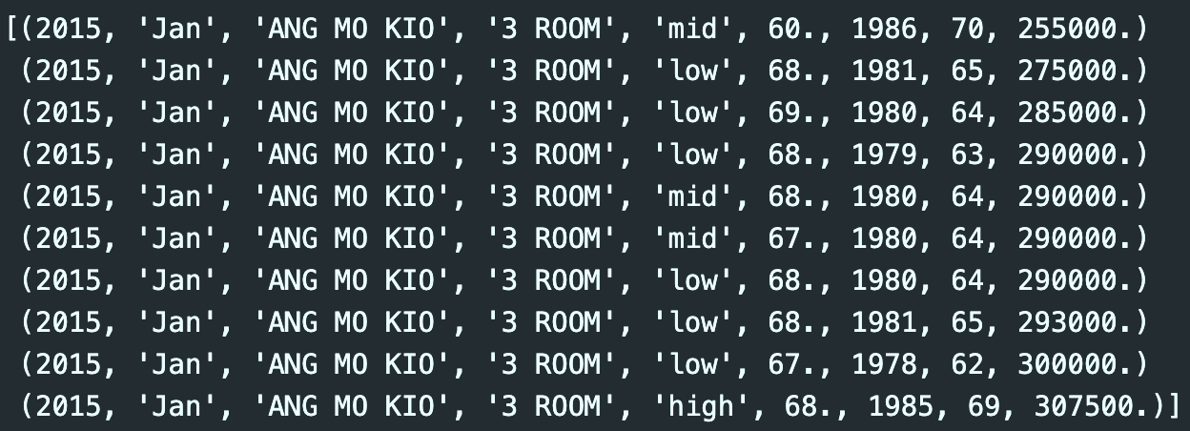
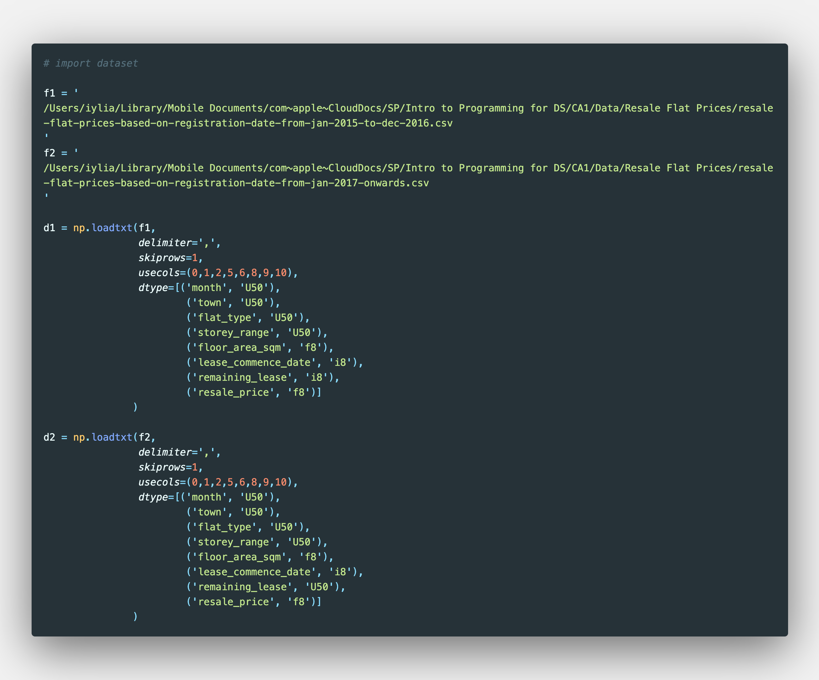
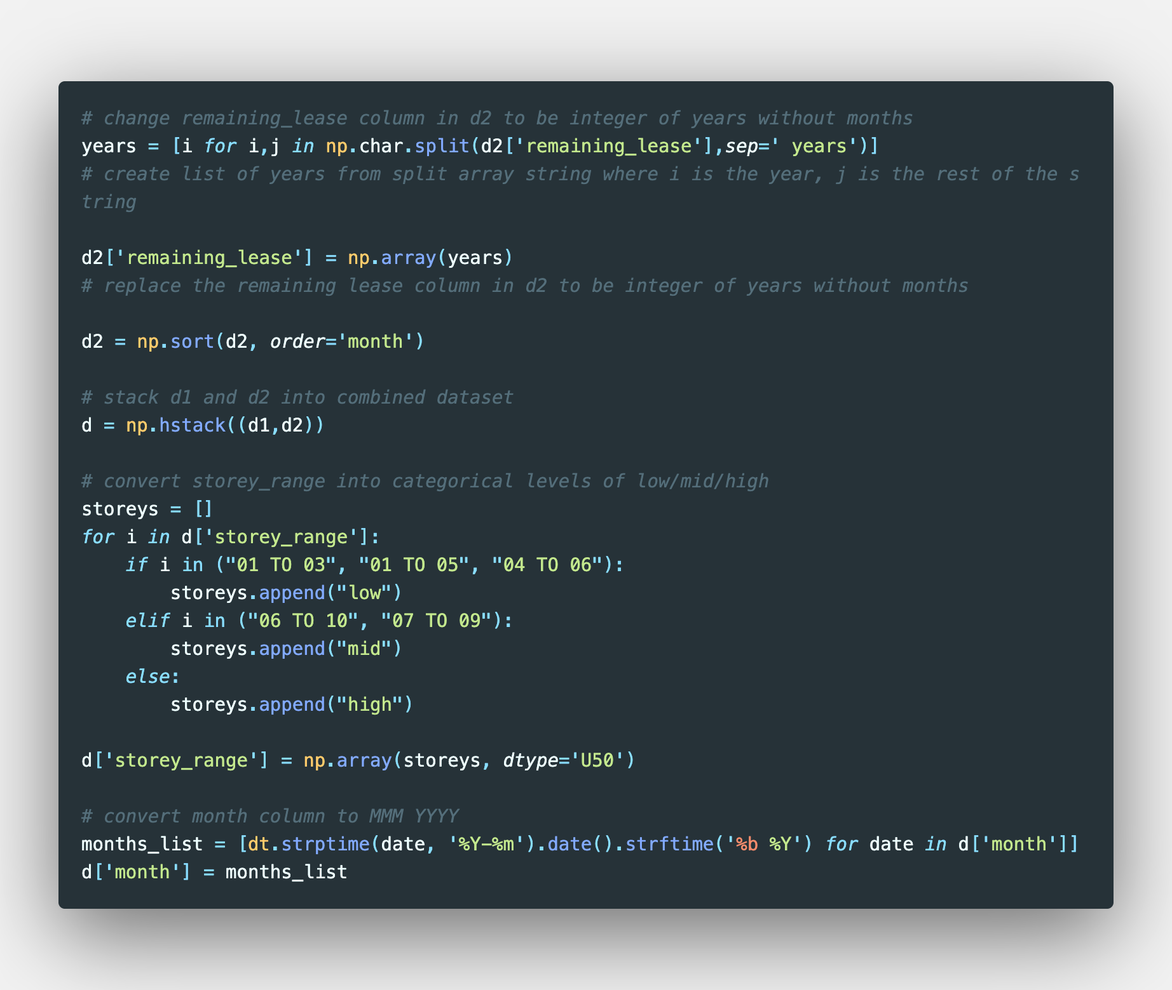
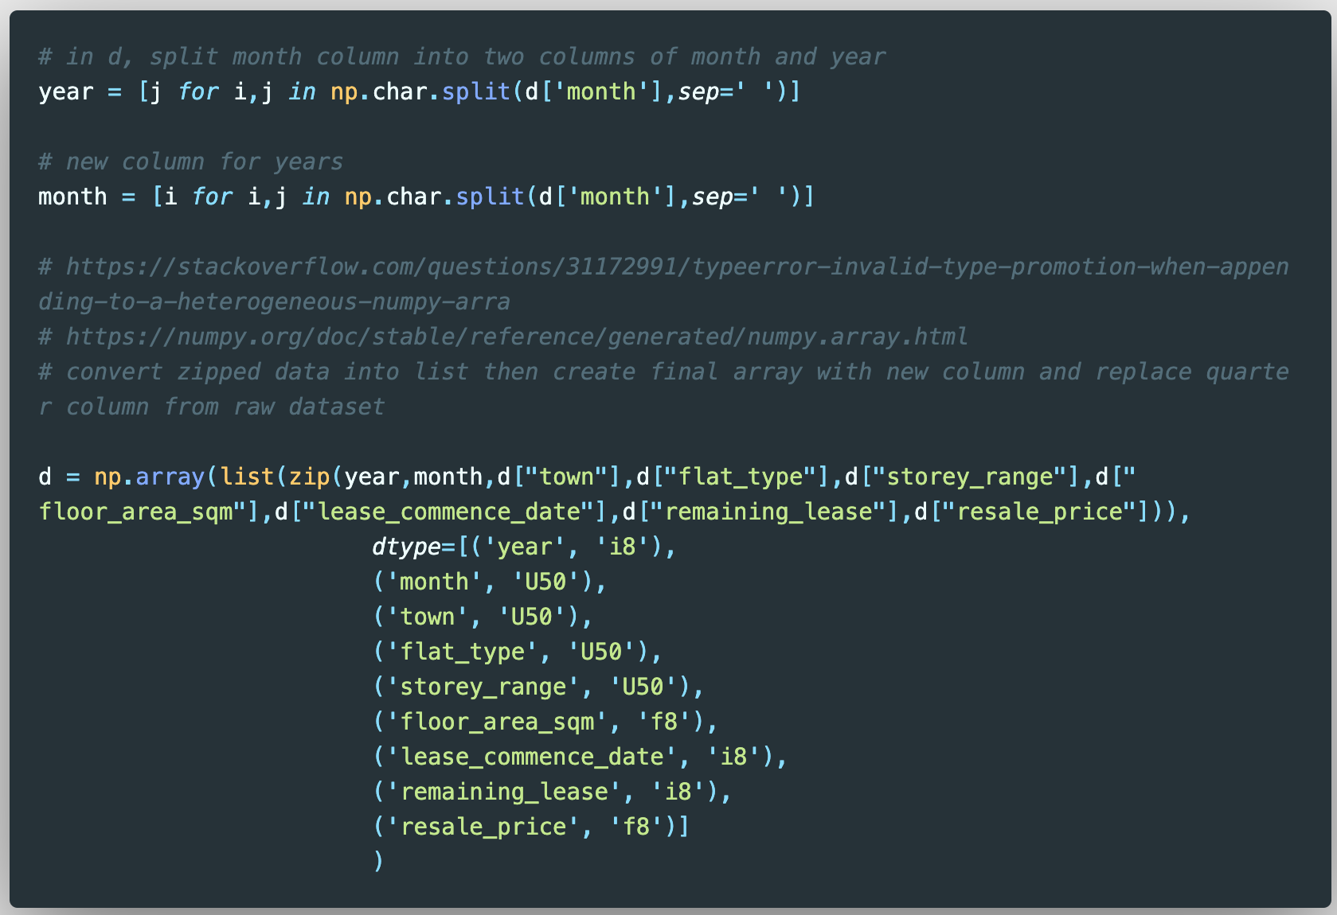
Resale Flat Prices
There are 180380 rows and 8 columns in this dataset
The names of the columns are:
year <class int64>
month <class <U50>
town <class <U50>
flat_type <class <U50>
storey_range <class <U50>
floor_area_sqm <class float64>
lease_commence_date <class int64>
remaining_lease <class int64>
resale_price <class float64>
Data transformation:
The dataset is a combination of data from the ‘2015 to 2016’ and ’2017 to present’ datasets
The ‘storey_range’ column was converted from numbered ranges to categorical levels of ‘low/mid/high’
The initial ‘month’ column obtained from data.gov.sg was split into the ‘year’ and ‘month’ columns

Slide 4
Resale Flat Prices
Data transformation:
The dataset is a combination of data from the ‘2015 to 2016’ and ’2017 to present’ datasets
The ‘storey_range’ column was converted from numbered ranges to categorical levels of ‘low/mid/high’
The initial ‘month’ column obtained from data.gov.sg was split into the ‘year’ and ‘month’ columns

Slide 5
Resale Flat Prices
Data transformation:
The dataset is a combination of data from the ‘2015 to 2016’ and ’2017 to present’ datasets
The ‘remaining_lease’ column in the ‘2017 to present’ dataset needed to be transformed so that it could be combined the the former
The ‘storey_range’ column was converted from numbered ranges to categorical levels of ‘low/mid/high’ using for and if-elif-else loops

Slide 6
Resale Flat Prices
Data transformation:
The initial ‘month’ column obtained from data.gov.sg was split into the ‘year’ and ‘month’ columns using np.char.split() and then zip()

Slide 7
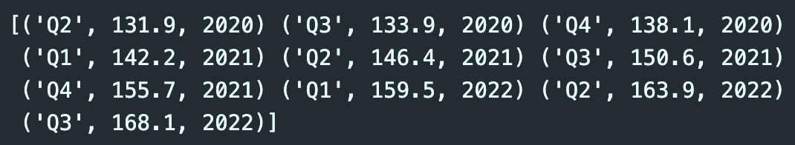
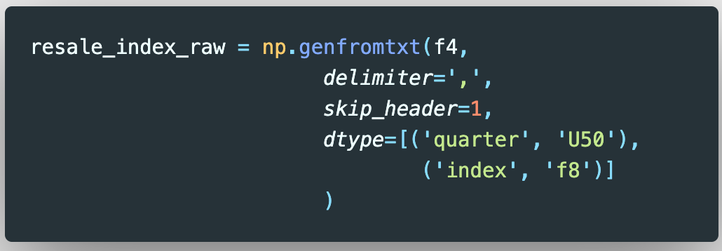
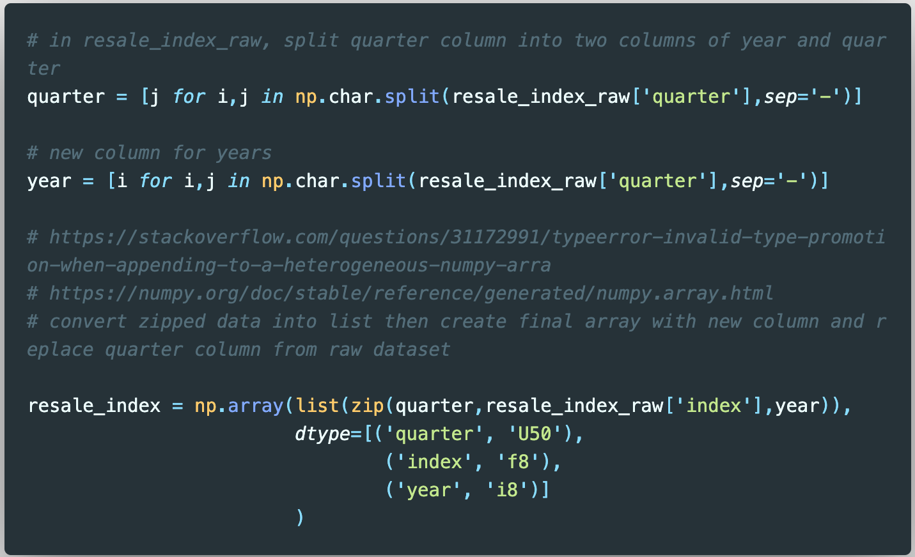
HDB Resale Price Index
There are 131 rows and 3 columns in this dataset
The names of the columns are:
quarter <class <U50>
index <class float64>
year <class int64>
The index calculates the average quarterly resale price while accounting for flat types, towns, and models.
Data transformation:
The initial ‘quarter’ column obtained from data.gov.sg was split into the ‘quarter’ and ‘year’ columns

Slide 8
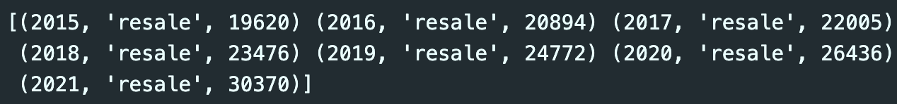
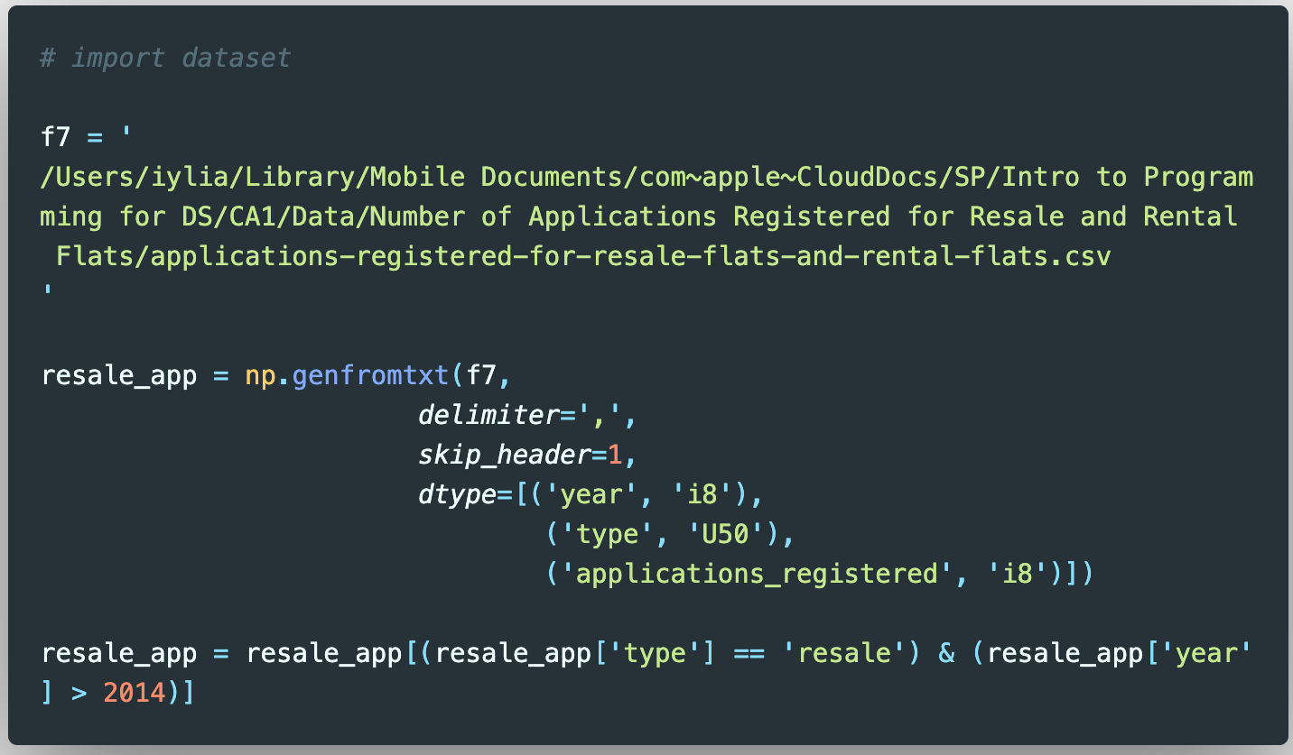
Number of Applications Registered for Resale Flats
There are 7 rows and 3 columns in this dataset
The names of the columns are:
year <class <int64>
type <class <U50>
applications_registered <class int64>
Data transformation:
The dataset was filtered for only resale flats and excluded for rental flats

Slide 9
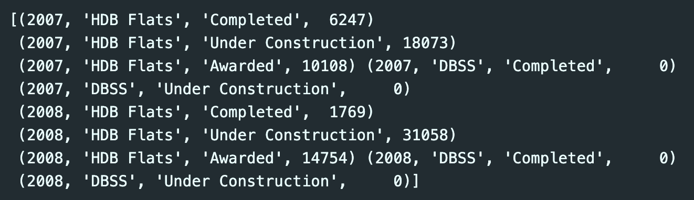
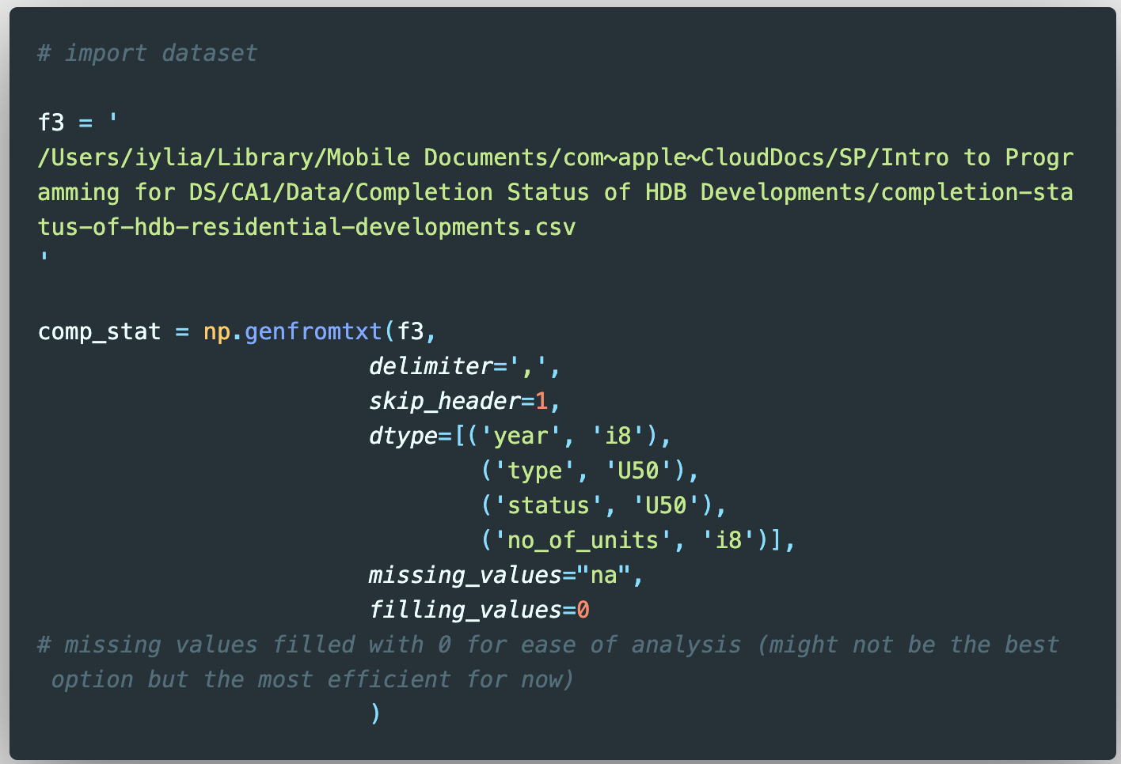
Completion Status of HDB Residential Developments
There are 75 rows and 4 columns in this dataset
The names of the columns are:
year <class int64>
type <class <U50>
status <class <U50>
no_of_units <class int64>
This dataset only includes new flats by HDB (incl. BTO, DBSS)
Data transformation:
The ‘no_of_units’ column had missing values indicated by ‘na’, which were filled with 0 values for ease of analysis

Slide 10
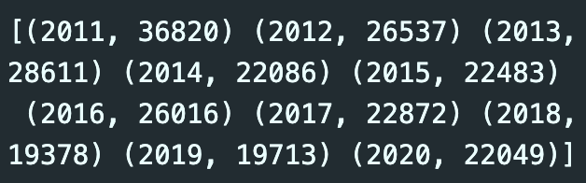
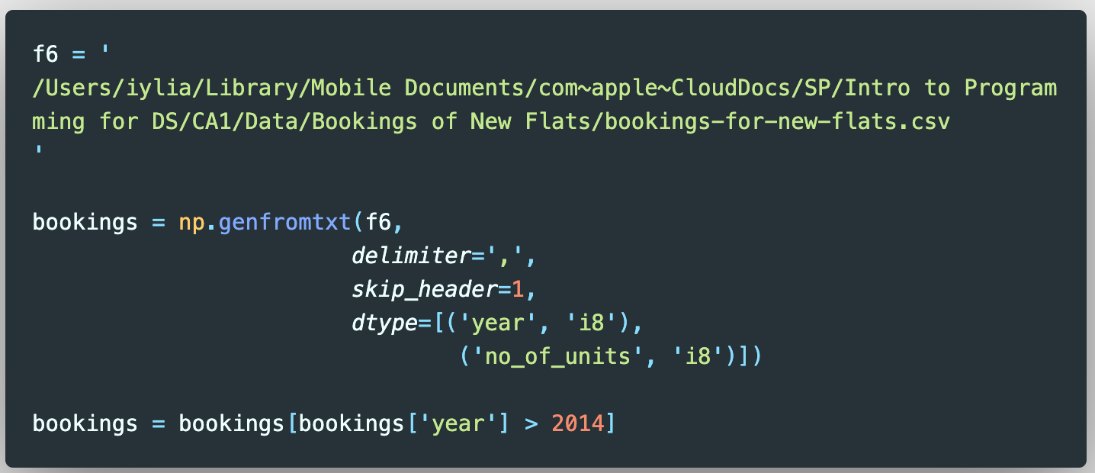
Bookings for New Flats
There are 11 rows and 2 columns in this dataset
The names of the columns are:
year <class <U50>
no_of_units <class int64>
This dataset only includes applications for new flats by HDB (incl. BTO, DBSS)

Slide 11
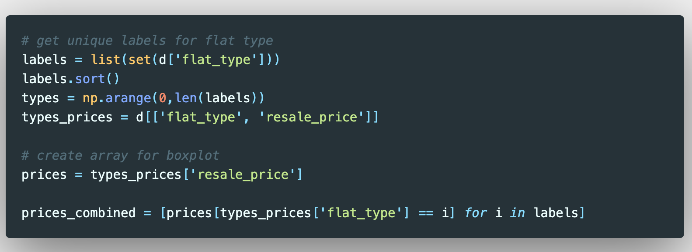
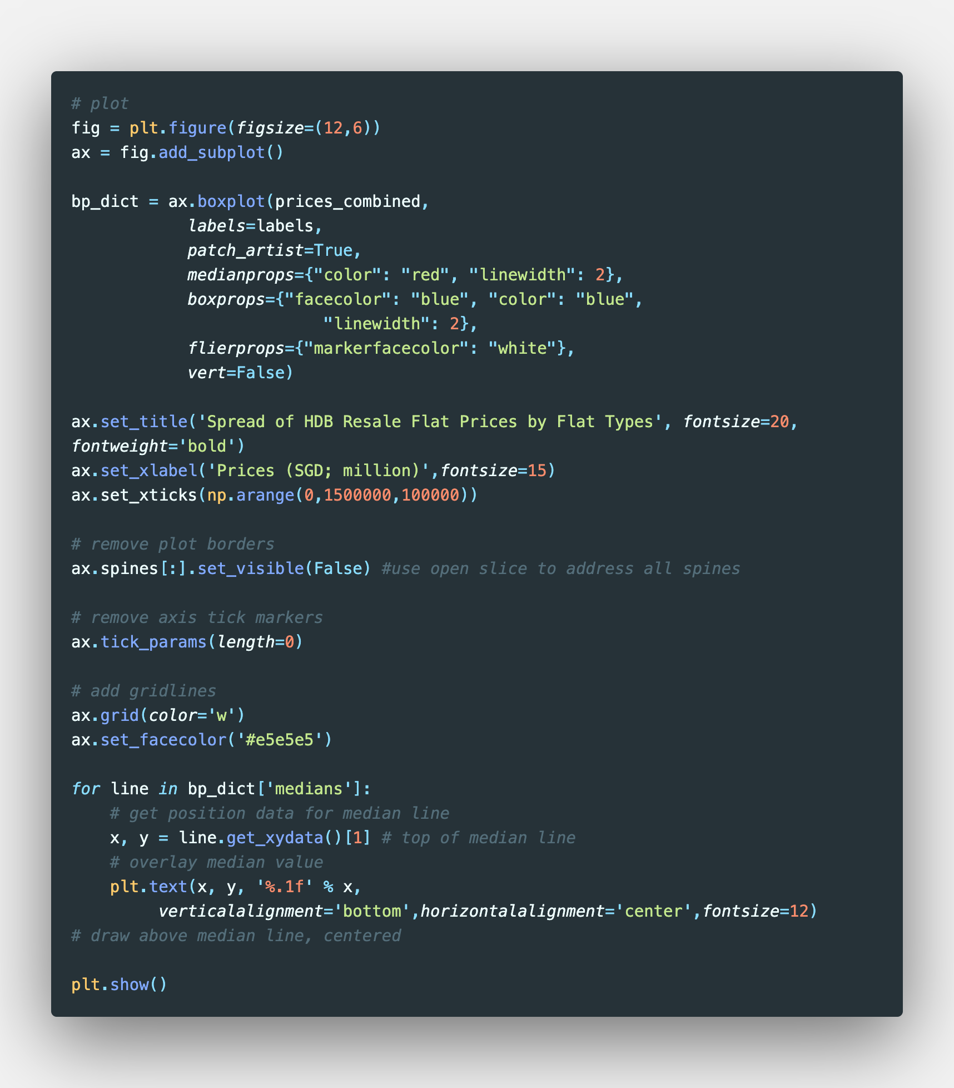
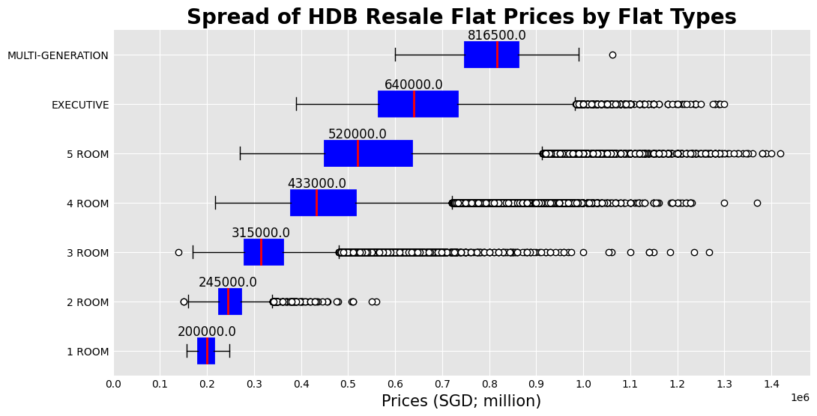
HDB Resale Flat Prices
Two lists were created for the Flat Type labels (‘labels’) and the range of prices for each flat type (‘prices_combined’)
Using the set() function and list comprehension respectively
The lists were used to create a boxplot of the spread of HDB Resale Flat Prices by Flat Types
Design and label attributes were added to the boxplot for better visualisation
Iylia Hutta

Slide 12
HDB Resale Flat Prices
Two lists were created for the Flat Type labels (‘labels’) and the range of prices for each flat type (‘prices_combined’)
Using the set() function and list comprehension respectively
The lists were used to create a boxplot of the spread of HDB Resale Flat Prices by Flat Types
Design and label attributes were added to the boxplot for better visualisation
Iylia Hutta

Slide 13
HDB Resale Flat Prices
As expected, the larger flat types see higher median prices than those of smaller types
Most flat types prices (except 1-room and Multi-Generation) are right-skewed with many outliers in the higher range of prices
The reason for skewness could be due to recent sales of resale flats hitting the price point of S$1m
Iylia Hutta

Slide 14
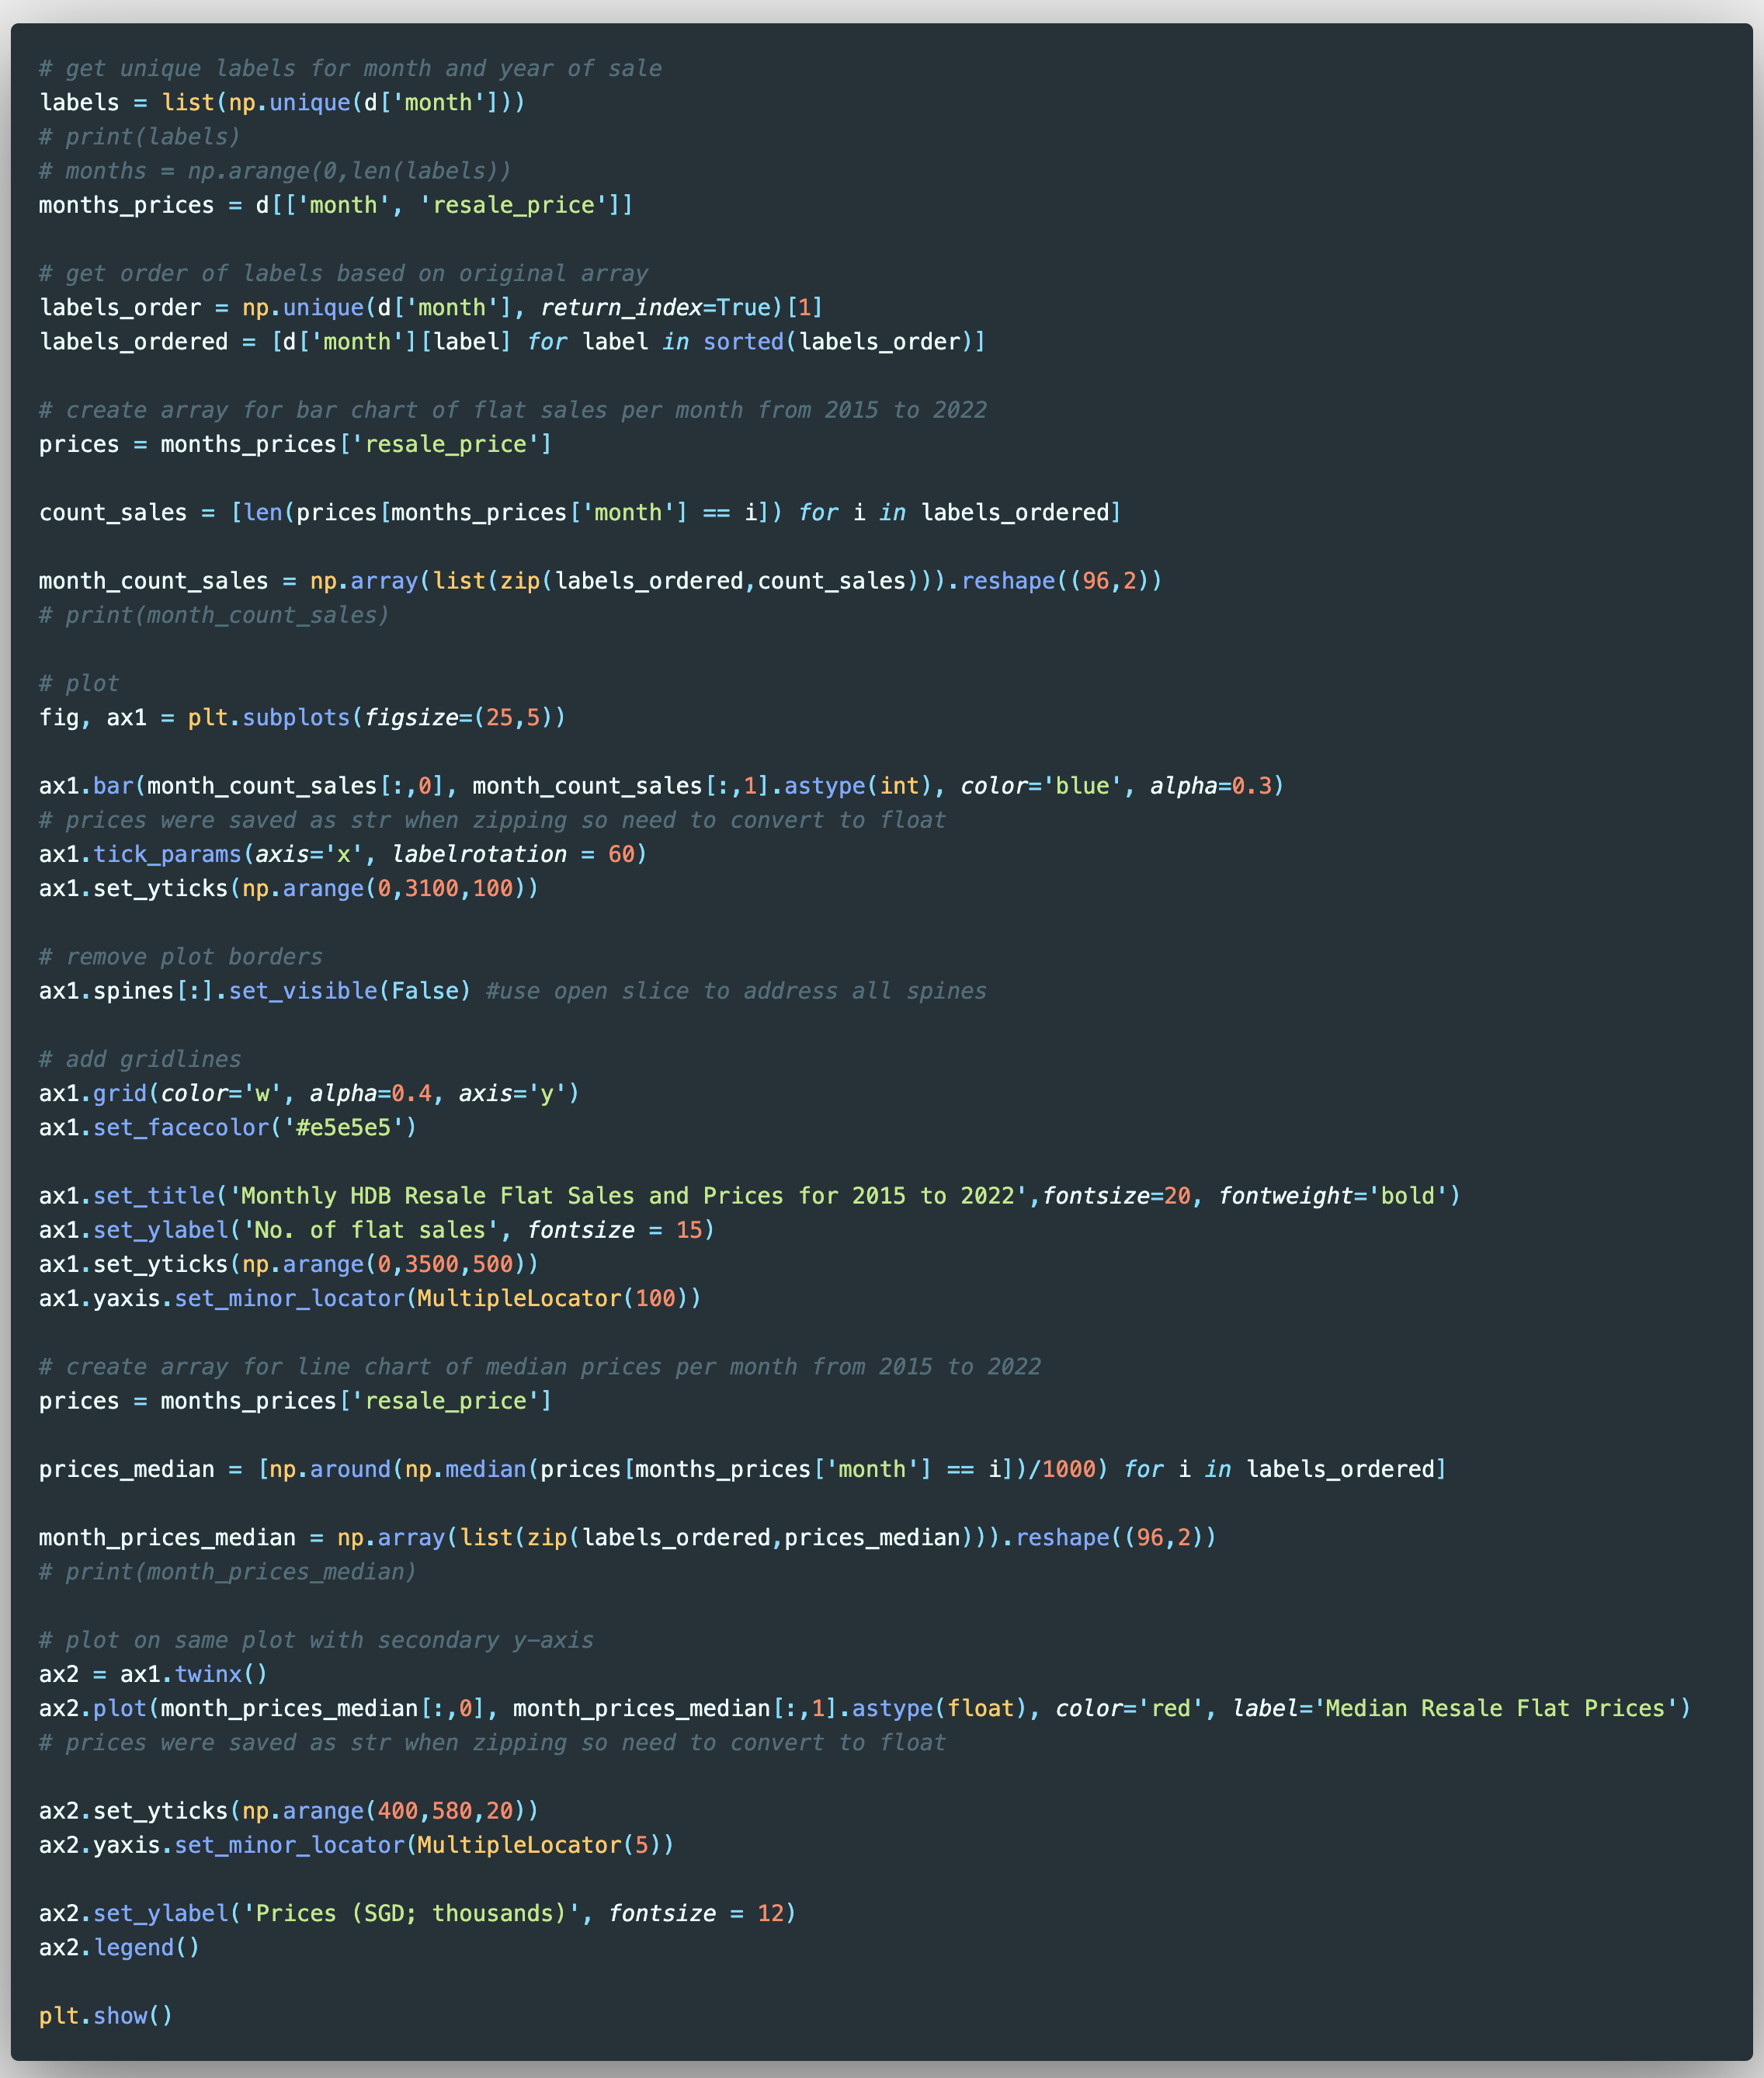
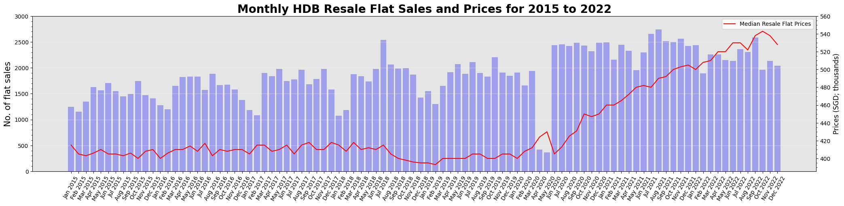
HDB Resale Flat Prices and Sales
List comprehension was used to create lists of the following:
Months and years labels (‘labels_ordered’)
Count of Resale Flat Sales (‘count_sales’)
Median Resale Flat Prices per month (‘prices_median’)
Median was used as the boxplot earlier showed that prices were skewed
Using the zip() function, the labels were combined with the other two lists to create 2D-arrays to create bar (‘month_count_sales’) and line (‘month_prices_median’) plots respectively.
The Axes.twinx() function was used to create the line plot overlaid on the bar plot, with secondary y-axis.
A legend was included to indicate which dataset the line plot refers to

Slide 15
HDB Resale Flat Prices and Sales
The time series chart shows that HDB resale flat prices have indeed risen over the past few years, with the largest jump occurring from June 2020 onwards, right after the Circuit Breaker period.
The increase in resale flat prices can be attributed to increased demand as many individuals or couples sought to get a place of their own after experiencing isolation at home during the Circuit Breaker and ensuing phases introduced by the MMTF in managing the pandemic.
Furthermore, the fall in prices seen towards the end of 2021 and 2022 could be attributed to property cooling measures introduced by HDB in December 2021 and October 2022 respectively.

Slide 16
HDB Resale Flat Prices and Sales
We can see that for the Circuit Breaker period, the overall median resale price drop was linked to a large drop in volume of HDB resale flats sold.
Additionally, across 2015 – 2022, most HDB resale flat transactions took place within February - November, with a typical fall in resale flat transactions at the beginning and end of the year.
After the introduction of the two property cooling measures mentioned earlier, resale flat sales volume also saw drops
The recent property cooling measures had the most impact on reducing resale flat sales volumes and prices compared to the ones introduced in December 2021

Slide 17
HDB Resale Flat Prices and Sales
While the overall prices for resale flat prices have not gone down in 2022, compared to recent years, the price trends started dropping earlier in the year (September) than in recent years where the drop would usually only be seen in November or even as late as December, considering it would be the holiday period where the general focus would be on other activities beyond homebuying.
Furthermore, with the resale data at it's most updated (as at 29 December 2022), the volume of resale flat sales saw a significant drop after the October 2022 property cooling measures.

Slide 18
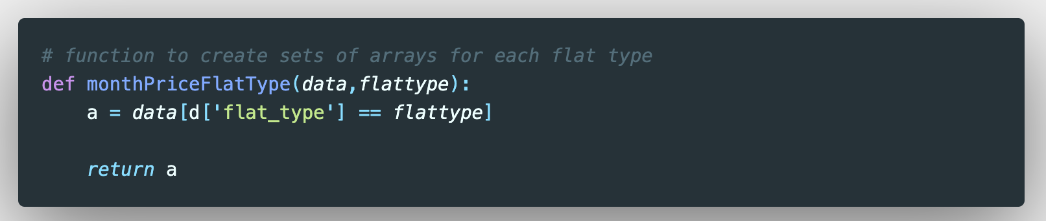
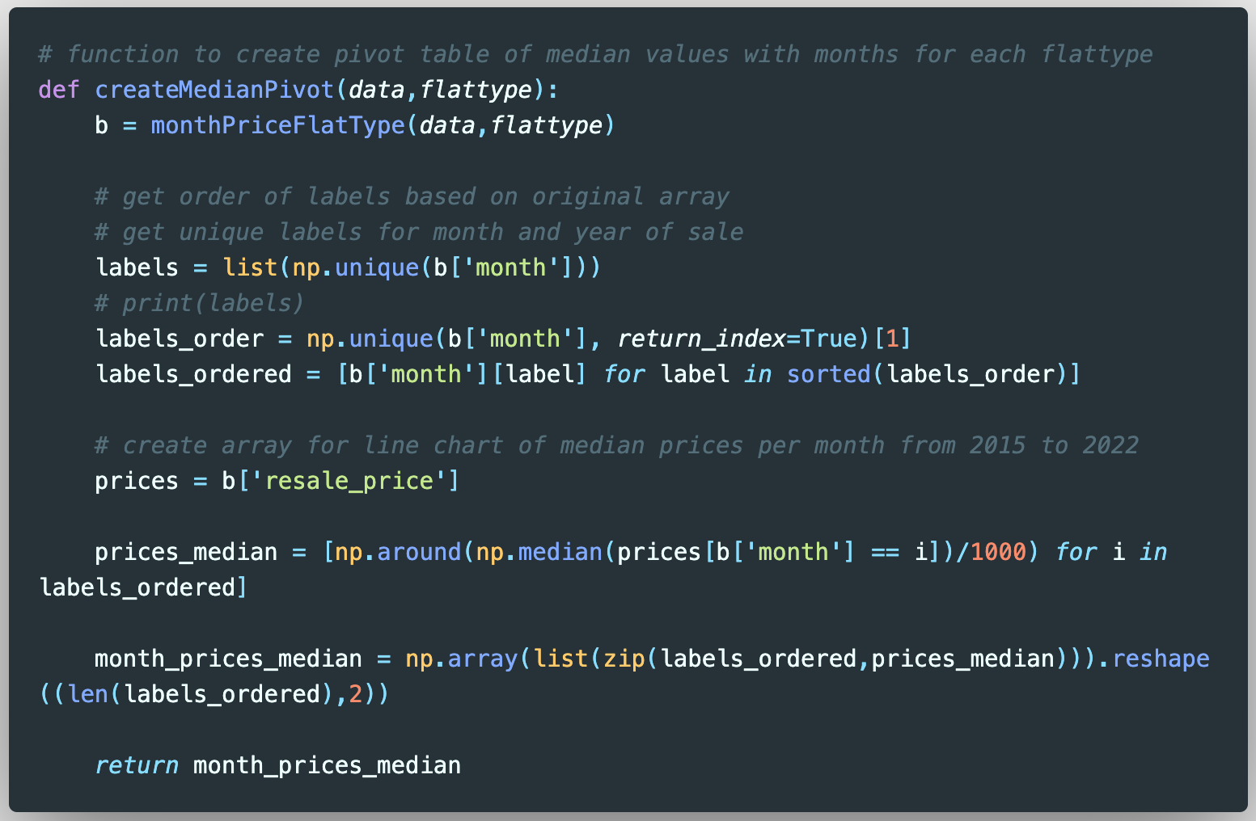
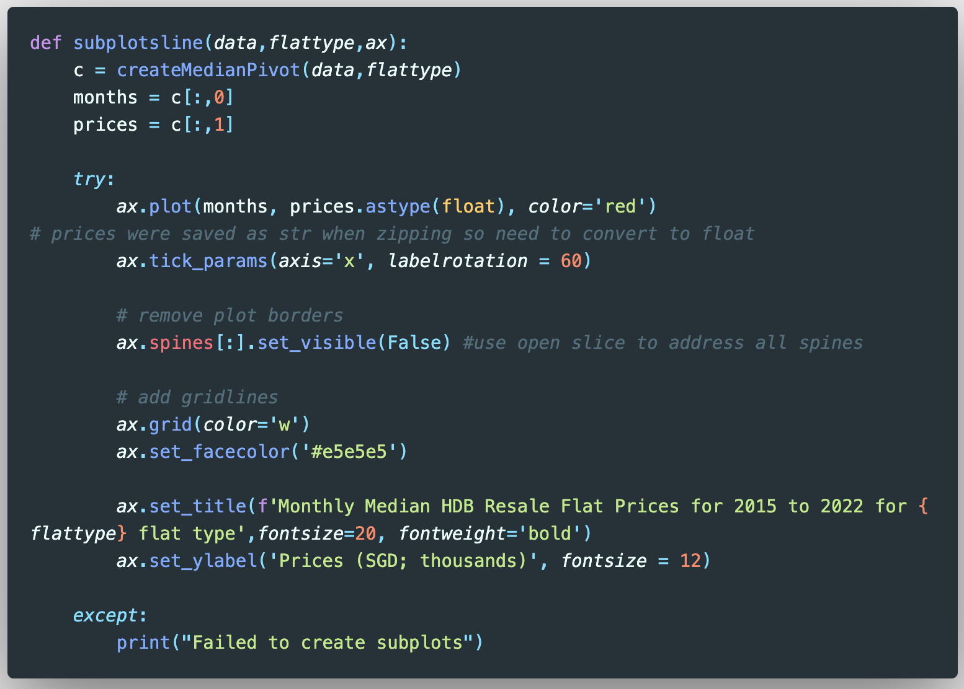
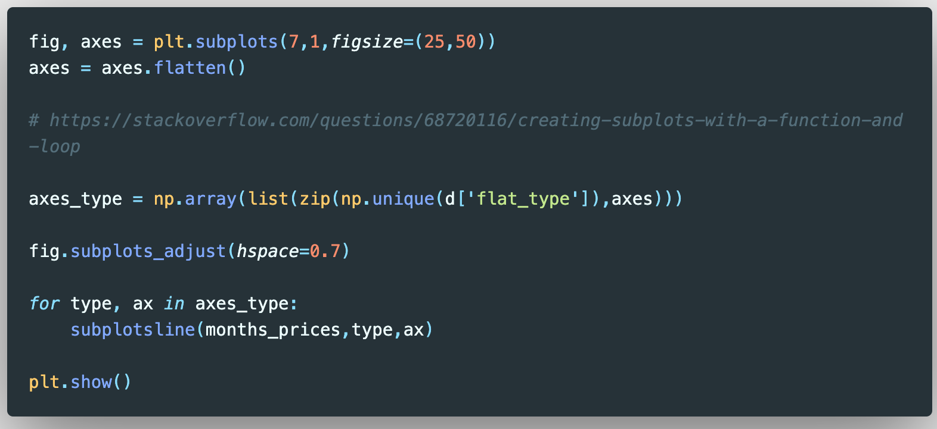
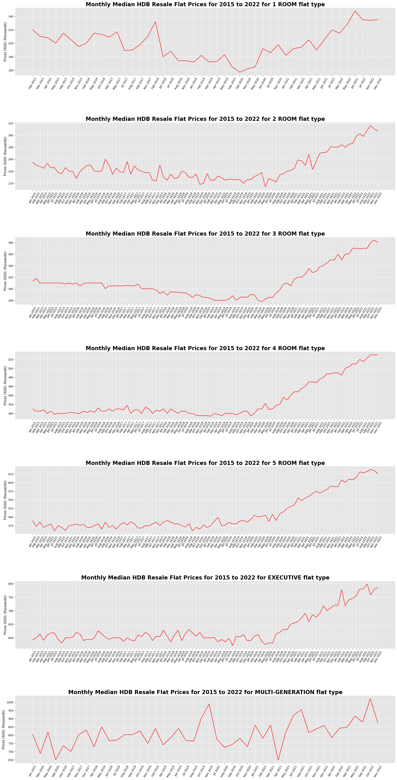
HDB Resale Flat Prices by Flat Types
The monthPriceFlatType function was defined to create a list that was filtered by the 7 flat types in the dataset
The createMedianPivot function was defined use the filtered list from the monthPriceFlatType function to create a ‘pivot table’ array of values of Month+Years and median prices for each month

Slide 19
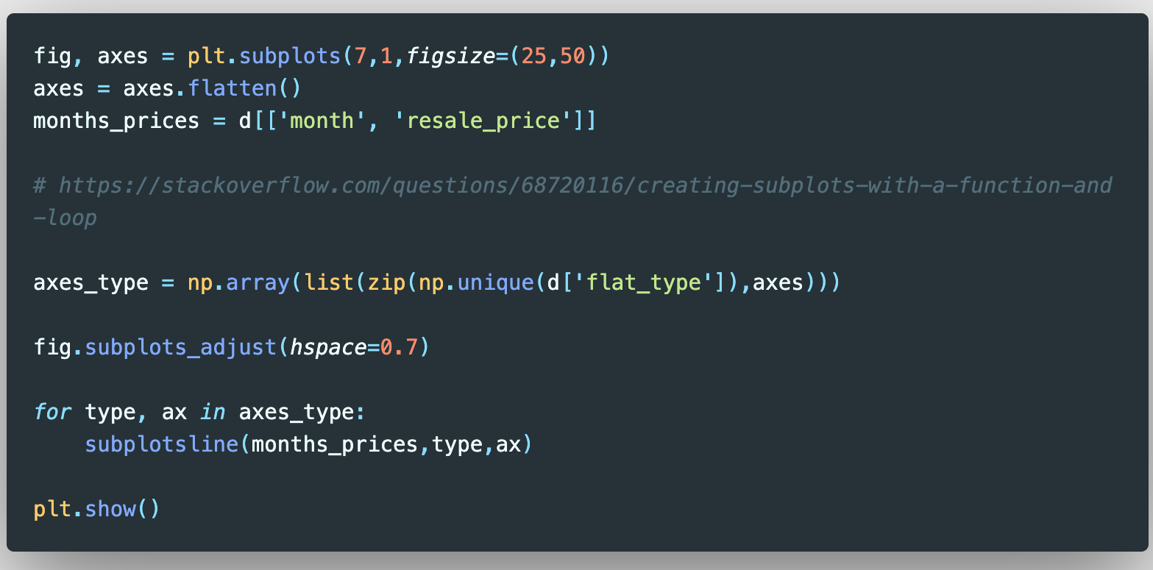
HDB Resale Flat Prices by Flat Types
The subplotsline function was defined to use the array from the createMedianPivot function to create a line plot of the data
try and except blocks were implemented for exception handling if the plotting failed due to any issue with the plotting code
An array ‘axes_type’ was created using the zip() function with unique values of the 7 flat types and the axes subplot objects
A for loop was used to iterate through the array with the subplotsline function, which produced a figure with 7 subplots for each flat type as defined by fig, axes

Slide 20
HDB Resale Flat Prices by Flat Types
The median prices of resale flats sold were consistently higher after the Circuit Breaker period than before, with prices for resale 2-, 3-,4-, 5-ROOM and EXECUTIVE flat types increasing significantly more than their median prices before the Circuit Breaker period, which can be known as the peak of the COVID-19 pandemic in Singapore.

Slide 21
HDB Resale Flat Prices by Flat Types
The 1-ROOM and MULTI-GENERATION flat types showed the most variability in median resale prices over the period of 2015 to 2022.
This could likely be due to the low prevalence of such flat types across towns in Singapore

Slide 22
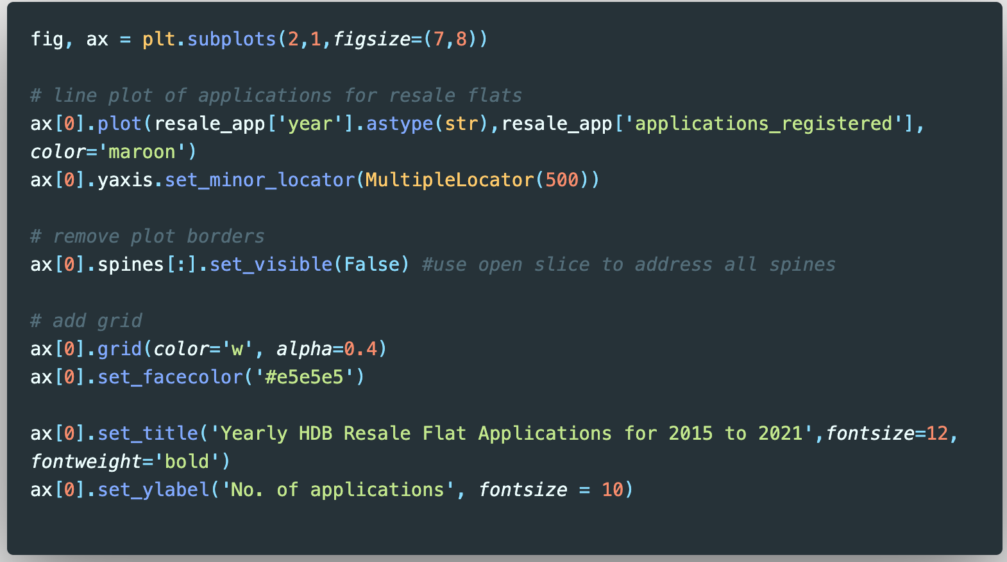
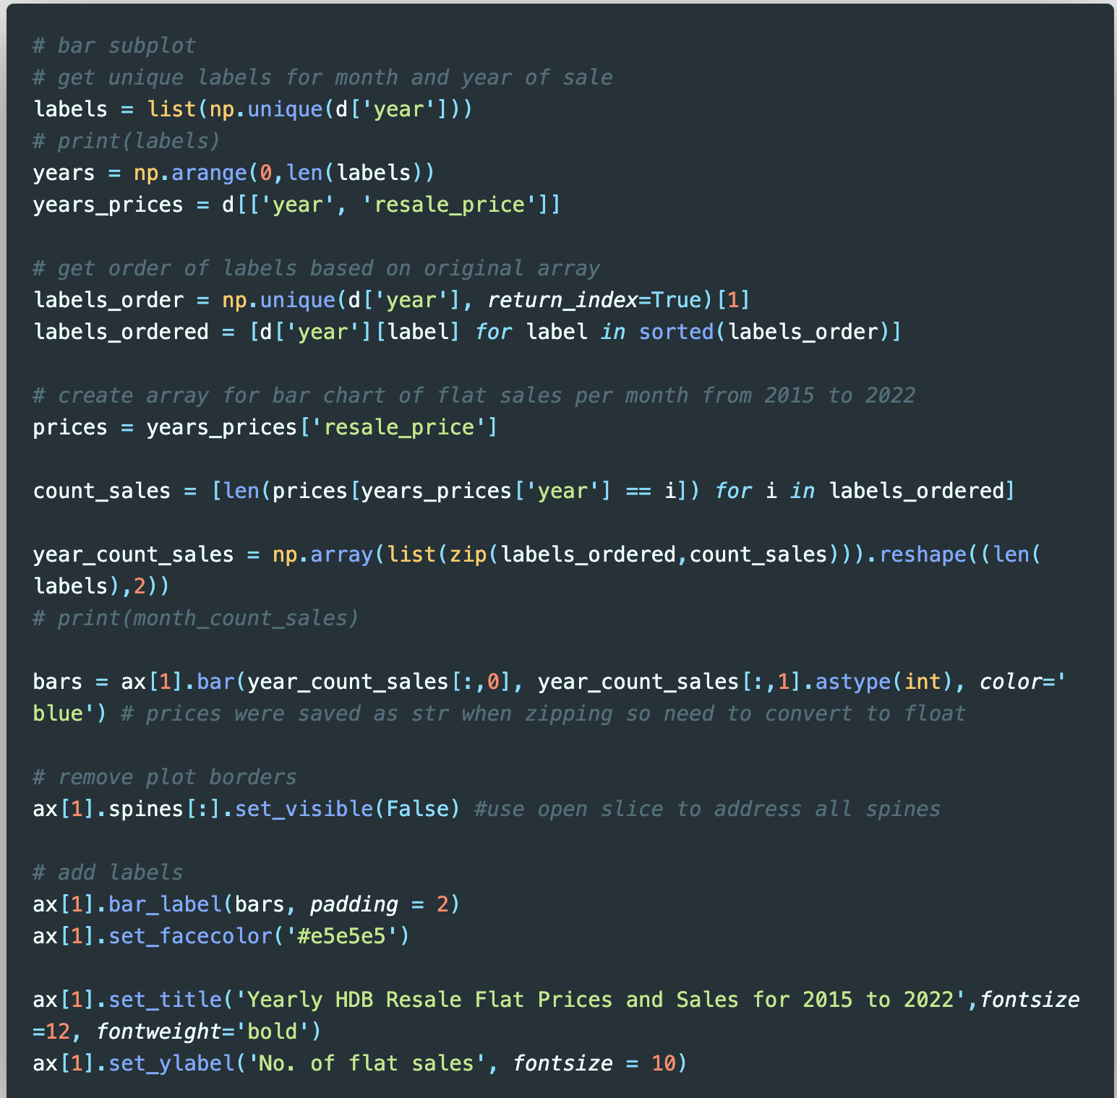
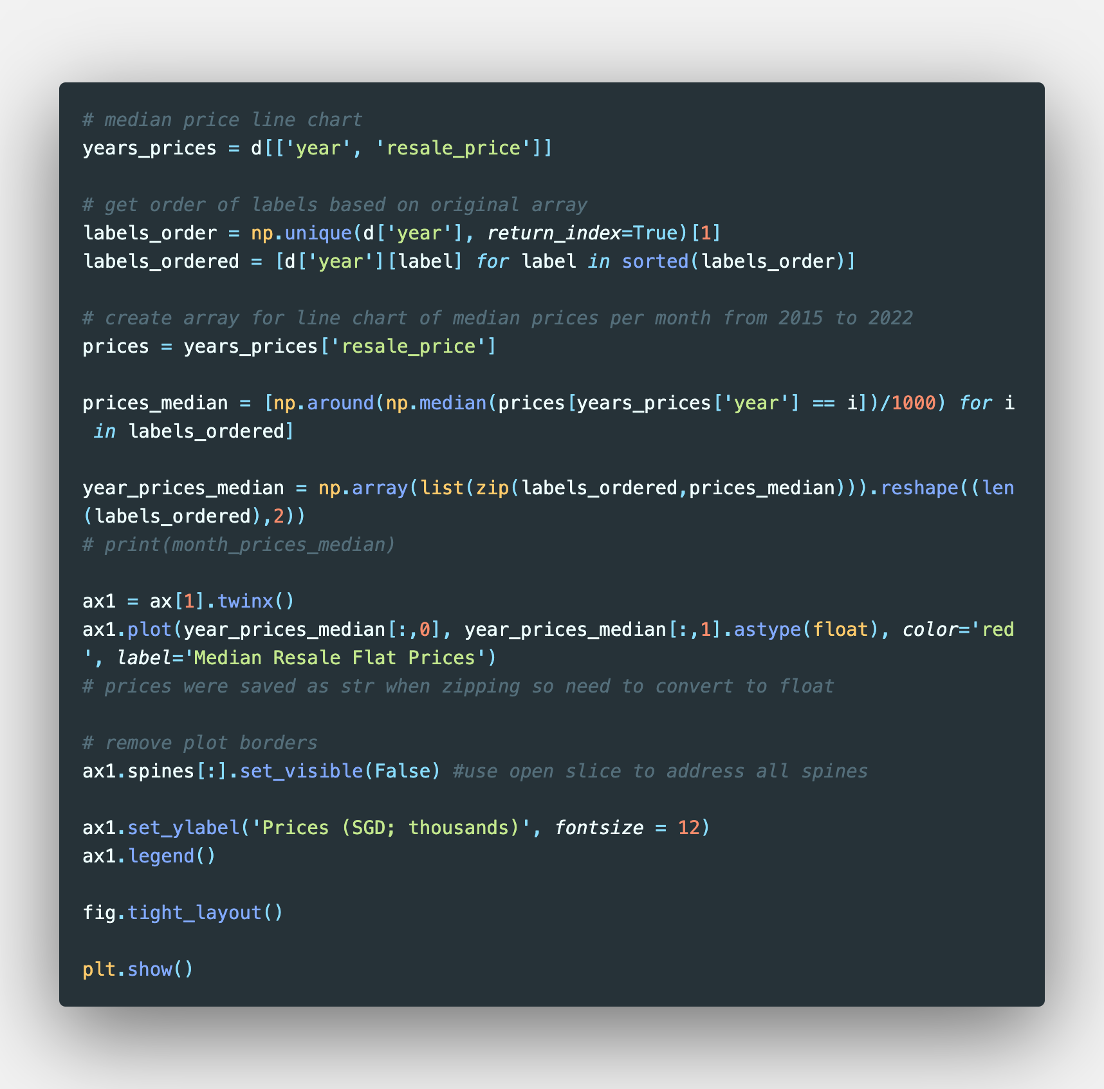
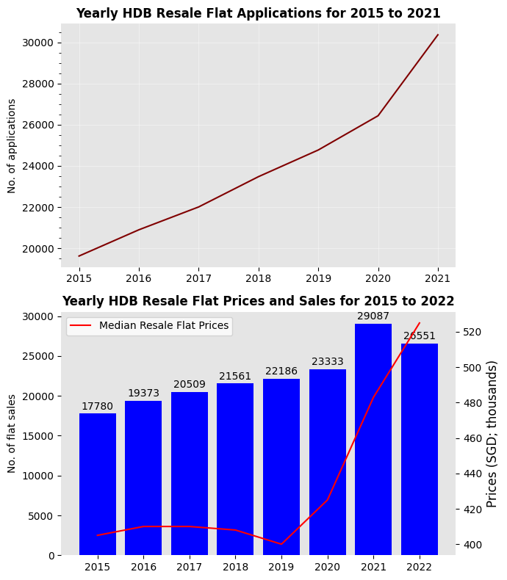
HDB Resale Flat Sales, Prices and Applications
The HDB Resale Applications dataset was used to create a line chart that will be compared with the HDB Resale Flat Prices and Sales line and bar charts

Slide 23
HDB Resale Flat Sales, Prices and Applications
The HDB Resale Flat Prices line chart was overlaid on the Flat Sales bar chart using the Axes.twinx() function to indicate shared x-axes.

Slide 24
HDB Resale Flat Sales and Applications
HDB Resale Flat Applications started exceeding the number of sold flats from 2016, which meant that demand exceeded supply
However, it can be inferred that excess demand from 2020 drove prices to increase at a higher rate than before
This was despite increased sales in 2021
Even with decreased sales in 2022, prices continued to rise

Slide 25
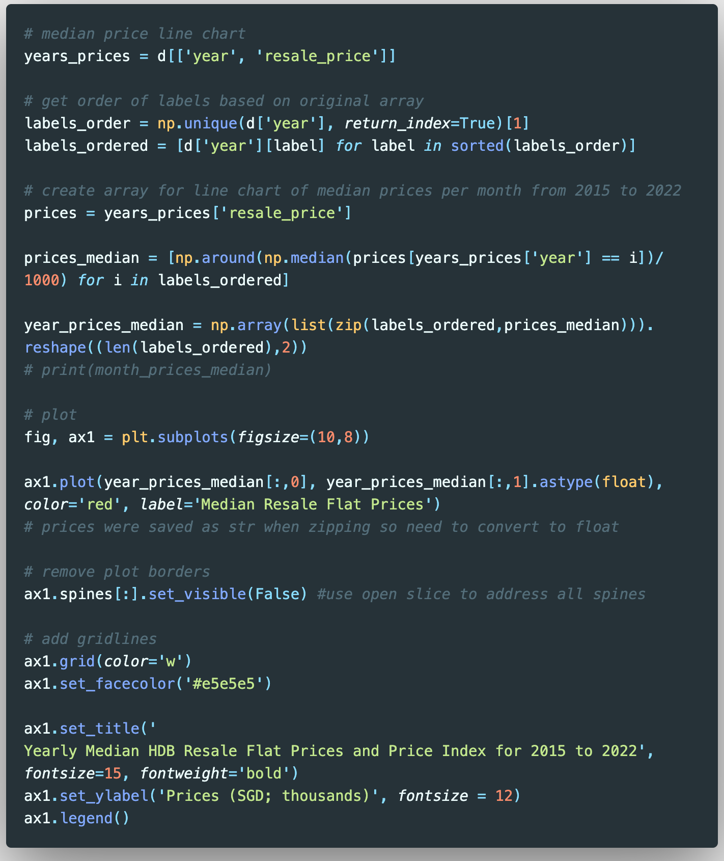
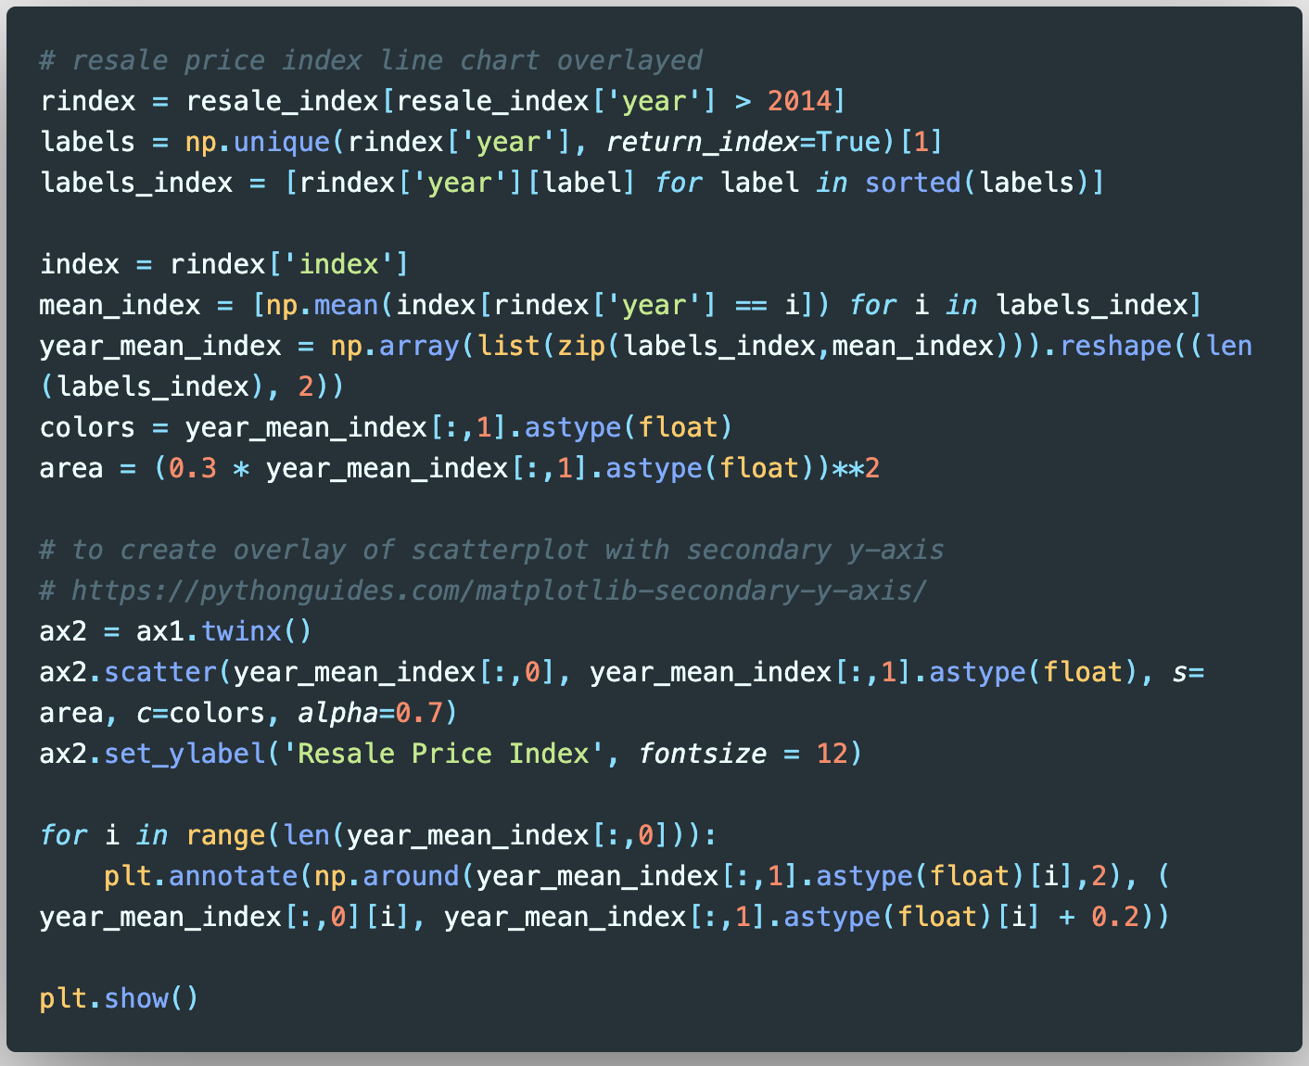
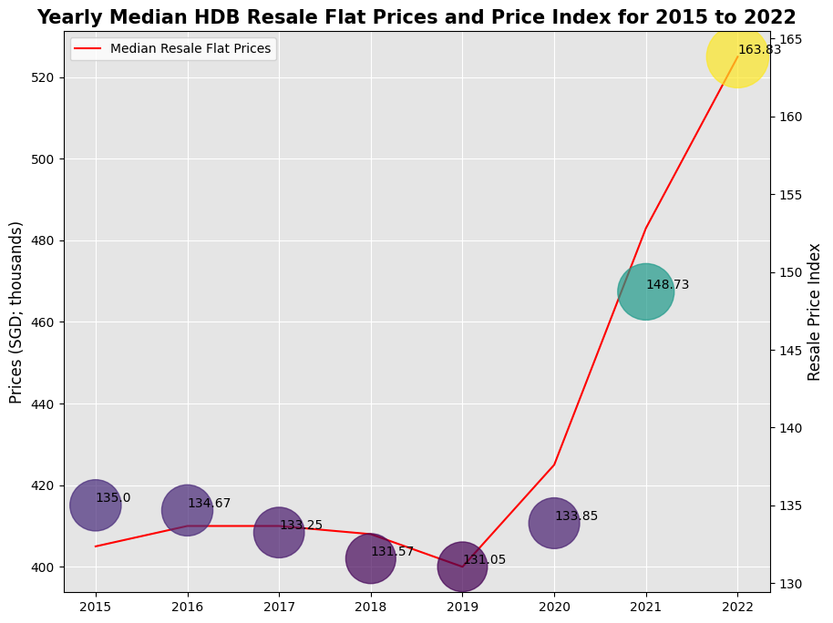
HDB Resale Flat Prices and Price Index
The HDB Resale Flat Prices dataset was used to create a line chart of median prices by years

Slide 26
HDB Resale Flat Prices and Price Index
The HDB Resale Price Index dataset was used to create a scatterplot of price indices by years
The indices were collected per quarter and so a new array (‘year_mean_index’) was created using the np.unique(), np.mean() and zip() functions for use in creating the scatterplot
The colours of the scatterplot were defined by the values of the calculated mean indices
The size of each point was defined by the values of the calculated mean indices with 0 to 0.15 point radii
The scatterplot as overlaid over the line chart using the Axes.twinx() function

Slide 27
HDB Resale Flat Prices and Price Index
Firstly, the resale price index and line plot of the median HDB resale flat prices show a similar trend where there was a dip in 2019, a slight increase in 2020 and then a sharp rise in 2021, which motivated the first introduction of property cooling measures in December 2021.
The dip in 2019 could be due to competition from new launches of HDB and private residences followed by the subsequent jumps in 2020 and 2021 when the COVID-19 pandemic hit and many wanted to move out of their family homes as soon as possible.
Nevertheless, while the absolute median prices for HDB resale flats have been falling since September 2022 (see slide 17), the resale price index, which accounts for the varying factors influencing resale flat prices, shows that HDB resale flat prices have increased further from 2021 to 2022, despite the increase relatively lesser than from 2020 to 2021.
The decrease in rate of increase in HDB resale flat prices could also be a result of the October 2022 property cooling measures.

Slide 28
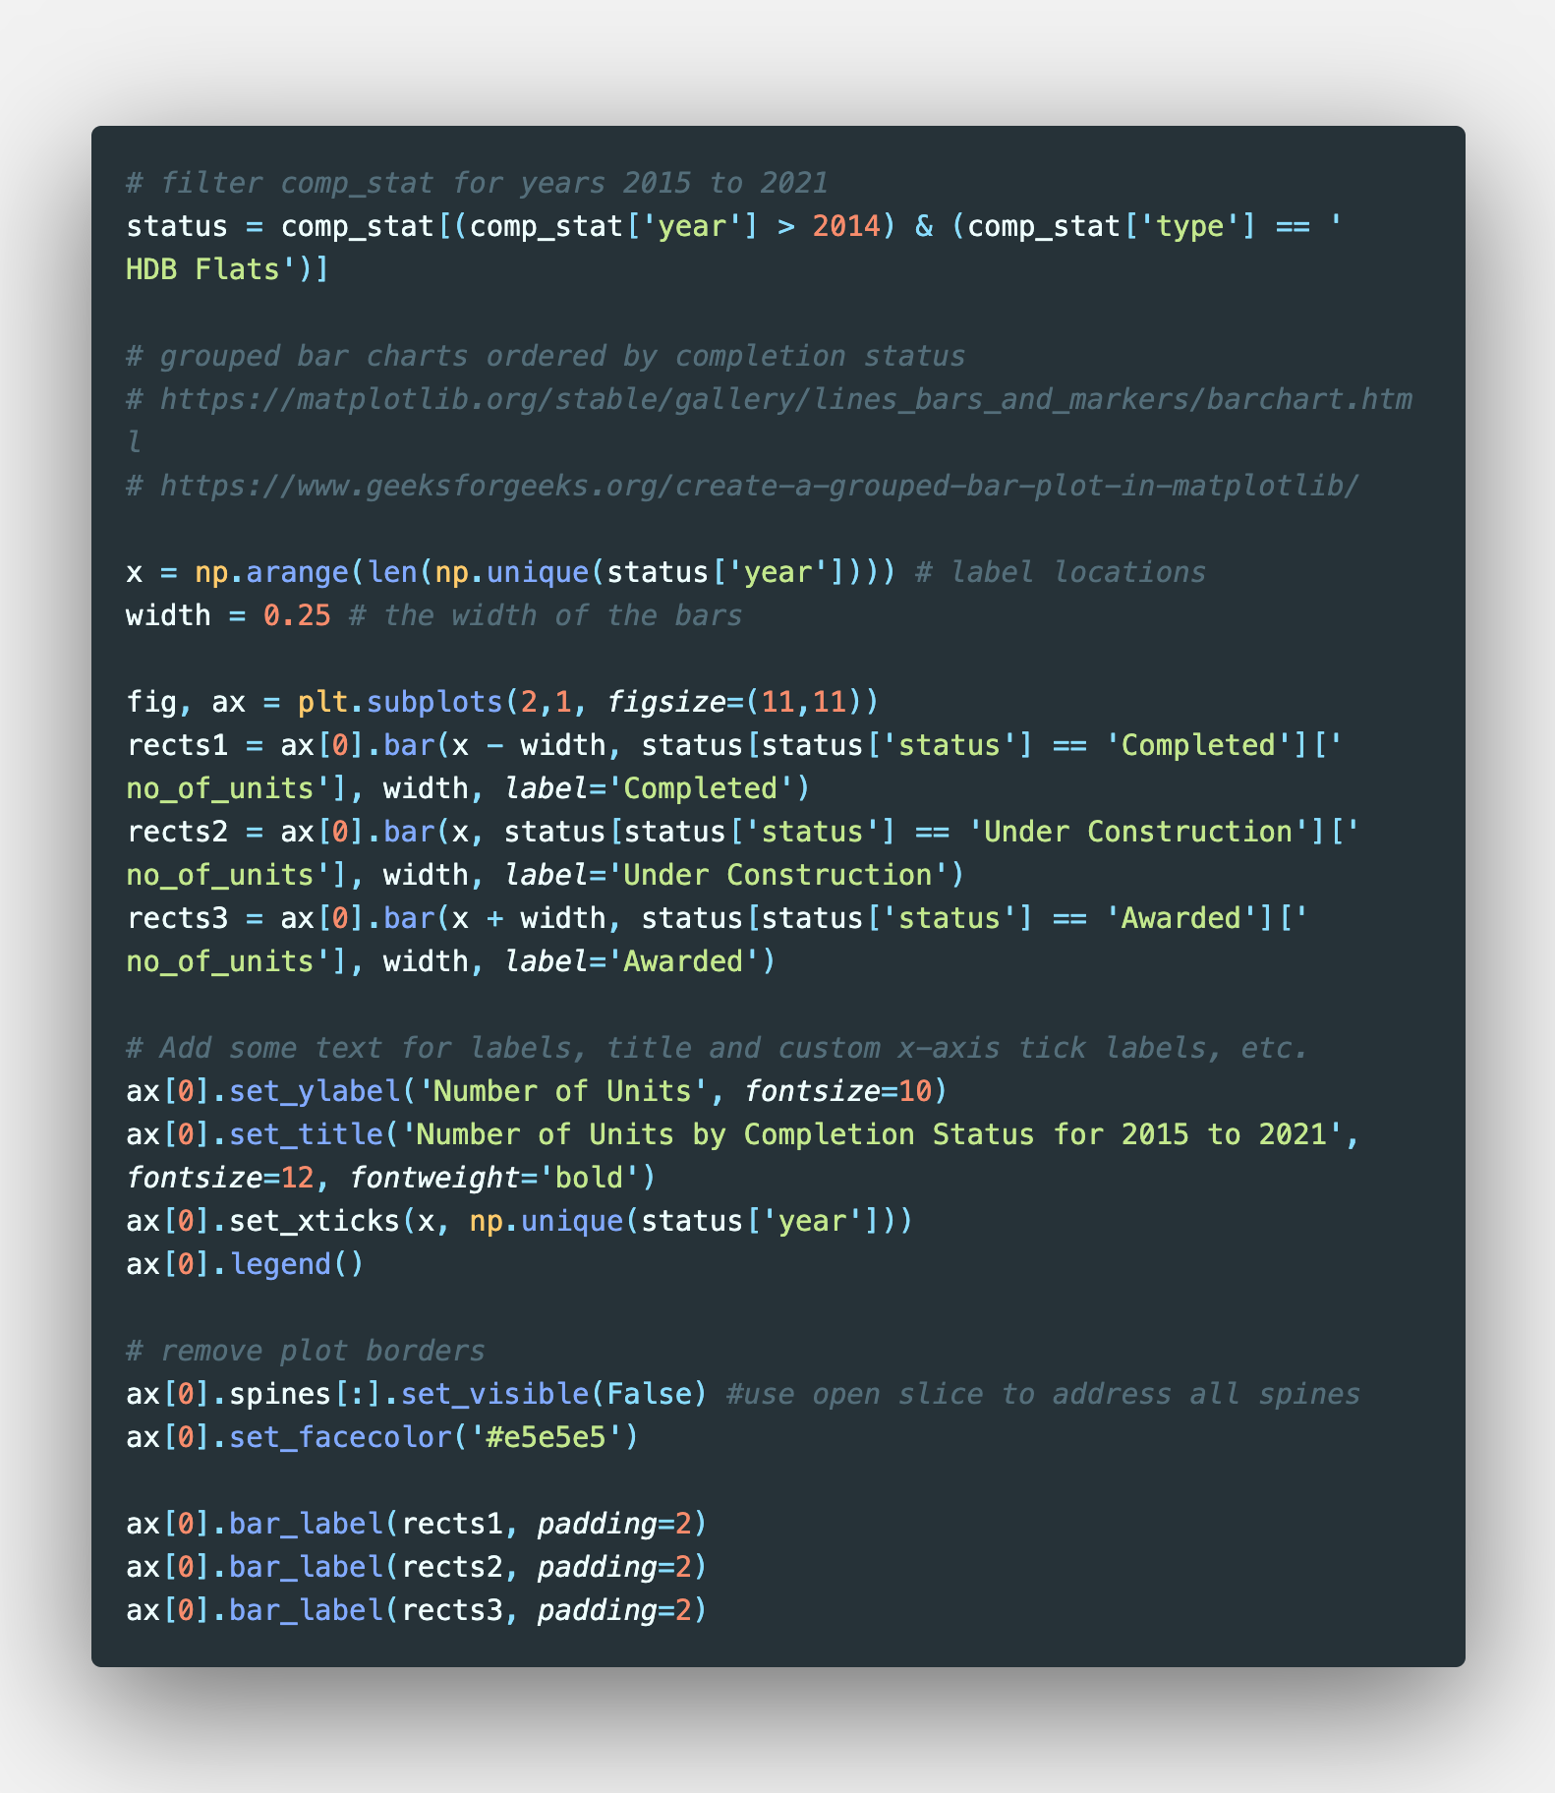
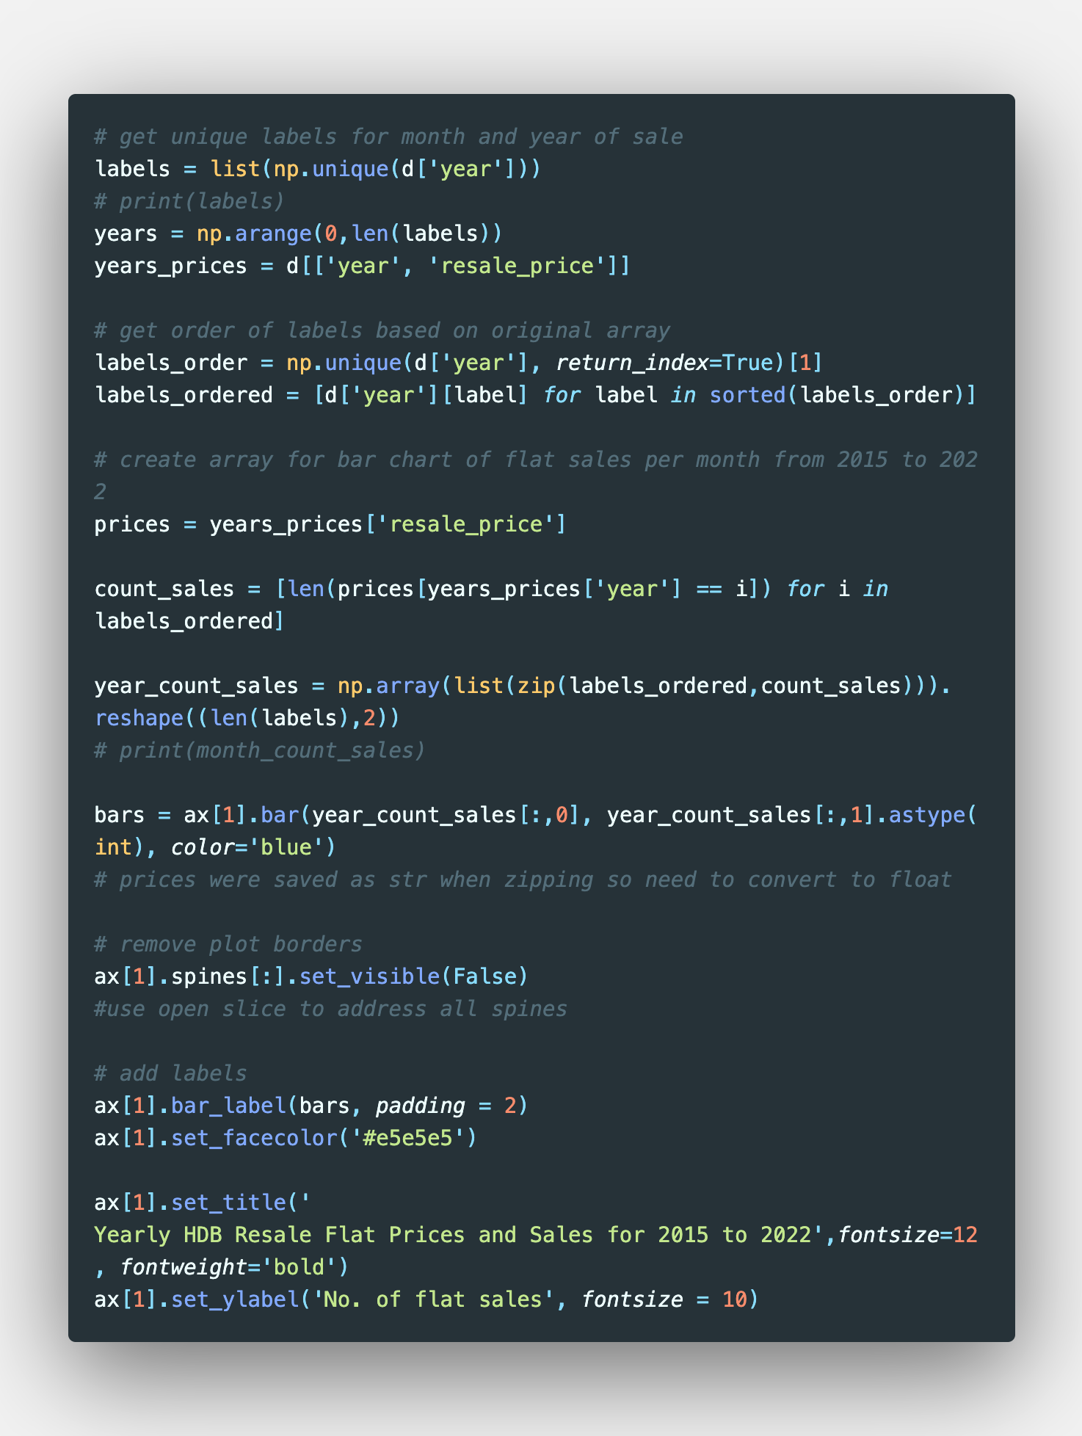
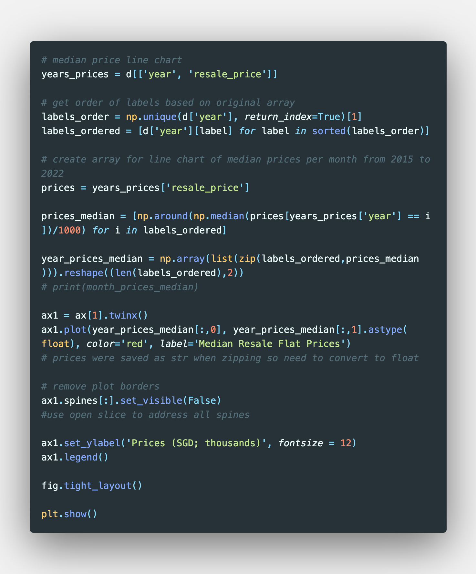
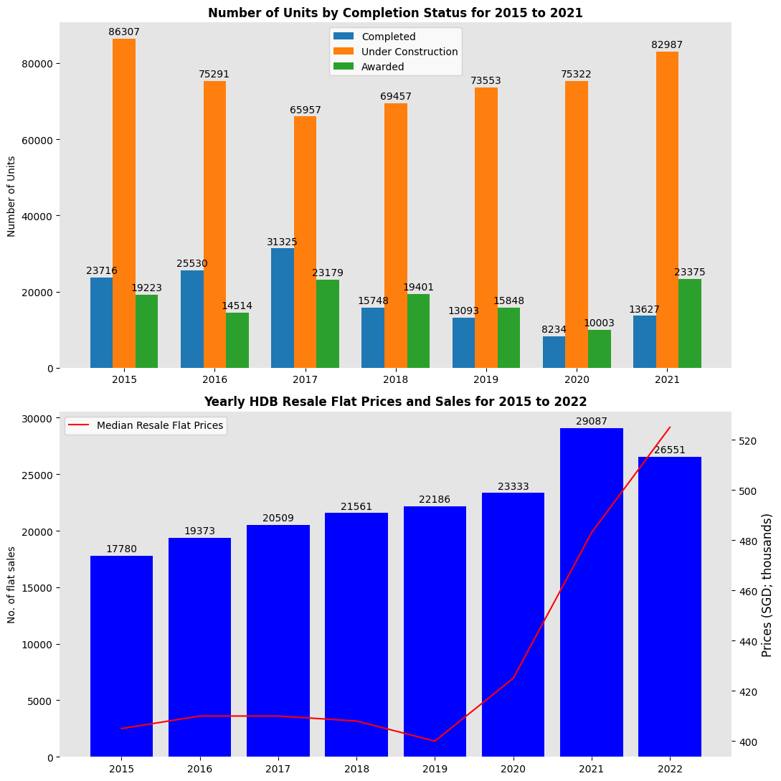
Completion Status of New HDB Flats
The Completion Status of New HDB Flats dataset was first filtered to include only HDB Flats and exclude rental flats and for data from 2015 to 2021
The data was then used to create a grouped bar chart showing the 3 different completion status of new HDB flats per year

Slide 29
Completion Status of New HDB Flats
The HDB Resale Flat Sales data was used to create a subplot of a bar chart to compare with the Completion Status of New HDB Flats data

Slide 30
Completion Status of New HDB Flats
The HDB Resale Flat Prices dataset was overlaid on the subplot of Resale Flat Sales using the Axes.twinx() function

Slide 31
Completion Status of New HDB Flats
The number of completed new HDB flats fell in 2020 from 2019, possibly motivating homebuyers to look to the resale market, contributing to the rise seen in the lower graph.
Furthermore, the relative similar numbers of HDB Units under construction from 2019 to 2020 could be attributed to the COVID-19 pandemic imposing pauses on construction due to supply chain disruptions and global economic shortages. This possibly further pushed homebuyers to the resale market in 2021.
Taken together with the increases in new HDB flats being awarded since 2019, the property cooling measures introduced in October 2022, and the still relatively high cost of resale flats, the resale market might moderate even further, as has been predicted by analysts recently.

Slide 32
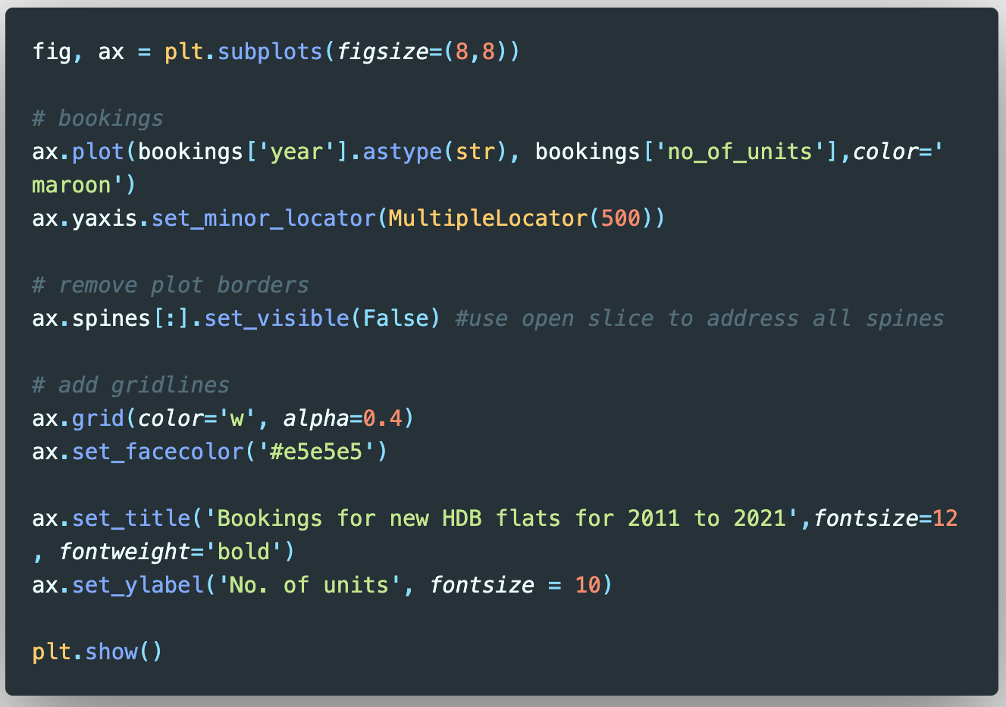
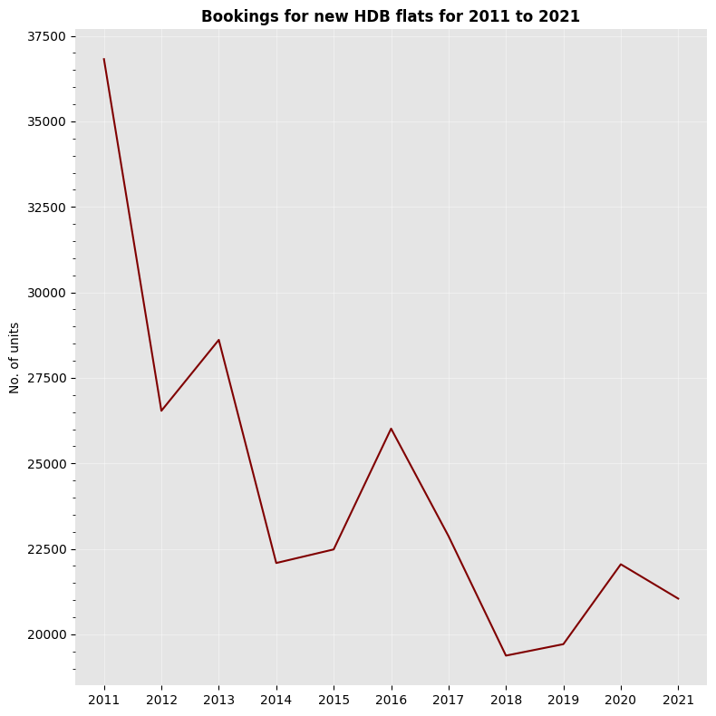
Bookings for New Flats
The Bookings of New Flats dataset was used to create a line chart for the number of new HDB units booked per year

Slide 33
Bookings for New Flats
With increasing BTO flat launches and increased pace of construction of new flats from 2022, it seems plausible that the bookings for new HDB flats might increase.
The fall in bookings for new HDB flats here are possibly linked to the lower numbers of launches in recent years prior to 2022.
Taken together with the increases in new HDB flats being awarded since 2019, the property cooling measures introduced in October 2022, and the still relatively high cost of resale flats, there is strong evidence that the resale market might moderate even further.

Slide 34
Conclusions and Recommendations
HDB Resale Flat Prices are at an all-time high following pent up demand driving sales and prices after the COVID-19 pandemic
Further exacerbated by construction delays and lower number of launches for new HDB flats
The October 2022 property cooling measures appear to be effective in reducing resale flat sales and prices as at 29 December 2022
Homebuyers who are able to do so would do good to hold off on buying a resale flat in the meantime as the data suggests that prices could moderate further in 2023, supported by various factors from this analysis:
Increasing new launches for HDB BTO flats and fall in resale flat sales, indicating decreasing demand
Monitoring the resale price index and sales volume across the first three quarters of 2023 will be crucial
Most price drops tend to occur in the December – January period
It would be best to wait for Q4 2023 or Q1 2024 to purchase a resale flat, if needed
Homebuyers who are able to wait can look forward to more supply of BTO flats in the coming years, which would be cheaper than resale flats

